Slide 1


Slide 2
THE HOUSE OF WISDOM
(CENTRAL ASIAN SCHOLARS)

Slide 3
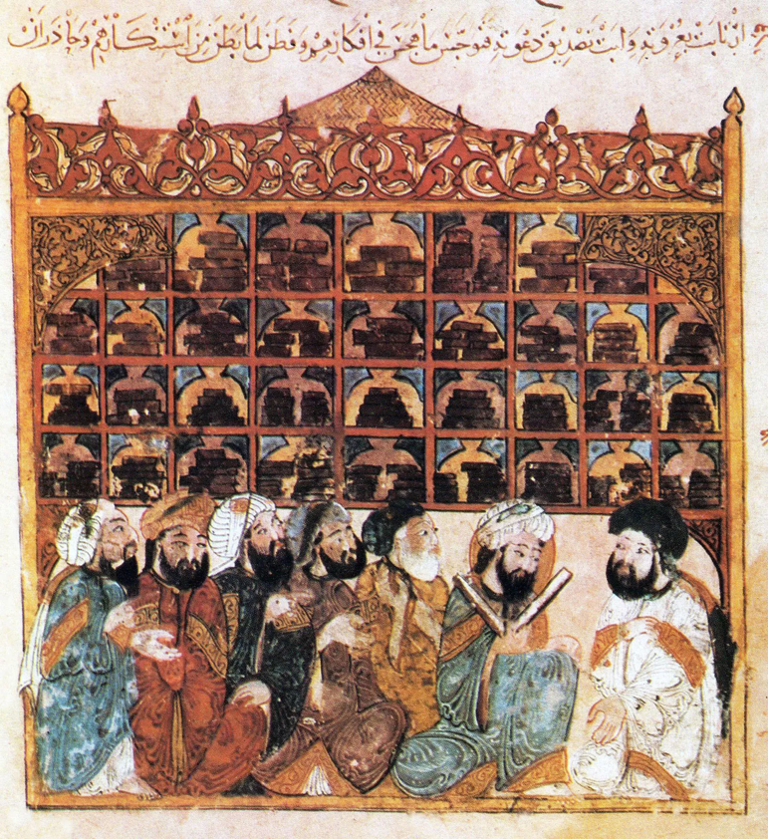

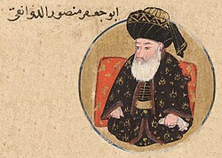
A palace library modeled after the Sasanian imperial library
Abu Ja’far al-Mansur (754-775)
sponsoring the translations of texts on astronomy and astrology
Government secretaries of Persian descent in al-Mansur's administration sponsored translations of Pahlavi texts on the history and principles of royal administration
Maqāmāt (The Assemblies) by al-Hariri.
Yahya ibn Mahmud al-Wasiti
1237 CE

Slide 4
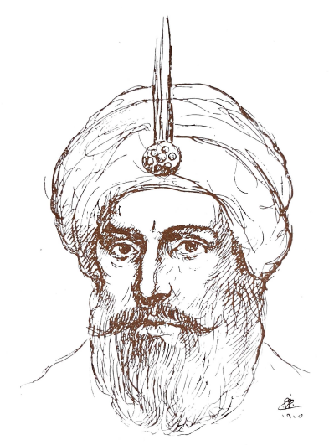
Bayt al-Hikmah, like Baghdad itself, was greatly enriched under the reign of Harun al-Rashid (786–809)
Harun’s reign was also the height of power for the Persian aristocracy
Barmakid family serving as the empire’s chief administrators

Slide 5
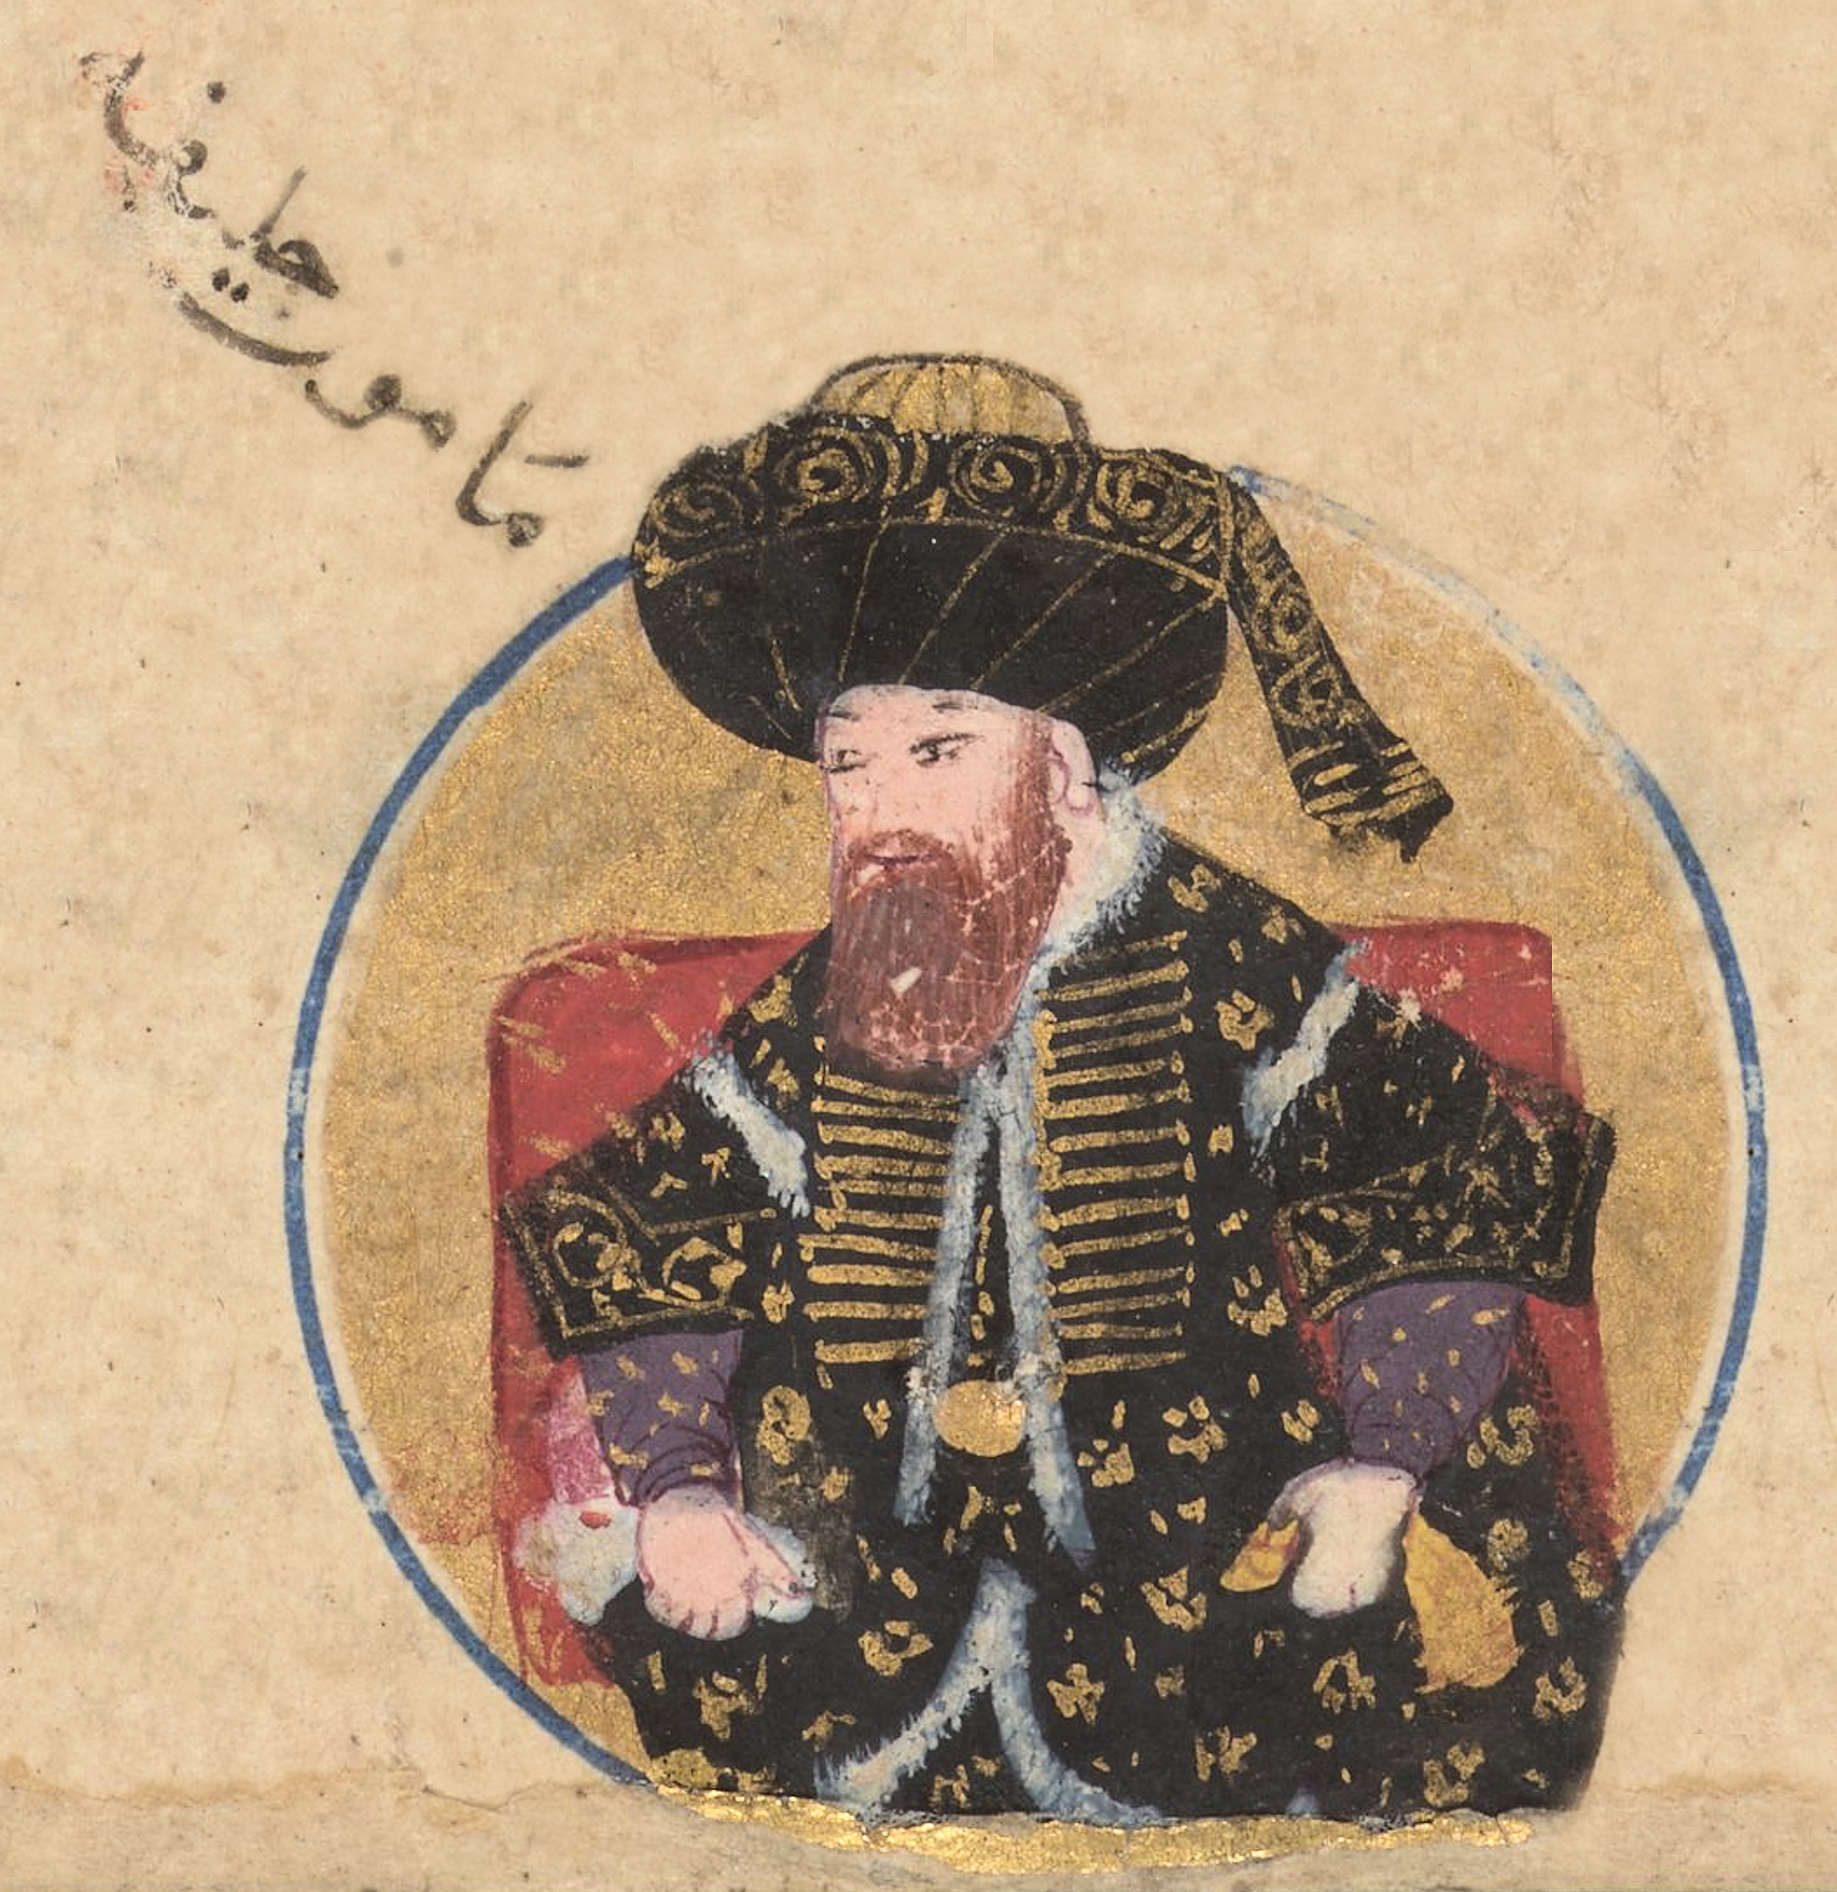
Bayt al-Hikmah reached its zenith under Harun’s son al-Maʾmun (reigned 813–833)
But it was also al-Maʾmun’s reign that brought about a change in wind for Bayt al-Hikmah, which was specialized in Persian knowledge before.
Al-Maʾmun switched gears and started paying scholars big money to translate Greek philosophy and science (like Aristotle, Plato, and Euclid) into Arabic instead.

Slide 6
using logic
using reason
Muʿtazilism
Using free will
forced it on everyone

Slide 7
Tensions between the caliphate and the old establishment continued into the reign of al-Muʿtaṣim (833–842).
Baghdad
Sāmarrā
Whatever may have remained of the collection in 1258 was destroyed in the Mongol sack of Baghdad
Bayt al-Hikmah
Capital

Slide 8
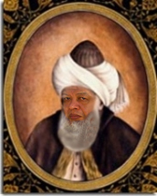
Medieval sources confirm that about twenty scholars from in the "Bayt al-Hikma" were from Central Asia.
Ahmad ibn Abdullah al-Marwazi
The first table of tangent and cotangents
Damascus Zij
"Astronomical tables" (Zij)
compiled in three volume
The Book of Bodies and Distances
(Kitāb al-ajrām wa-l-ab 'ād)
"Black accountant" (al-Habash al-Hasib).
Marw

Slide 9
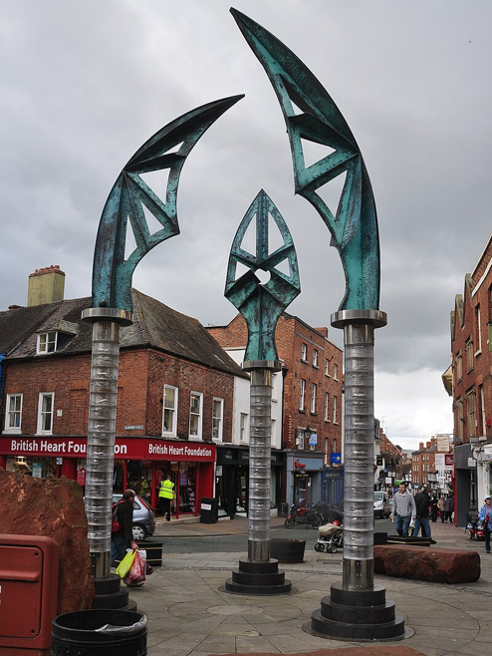
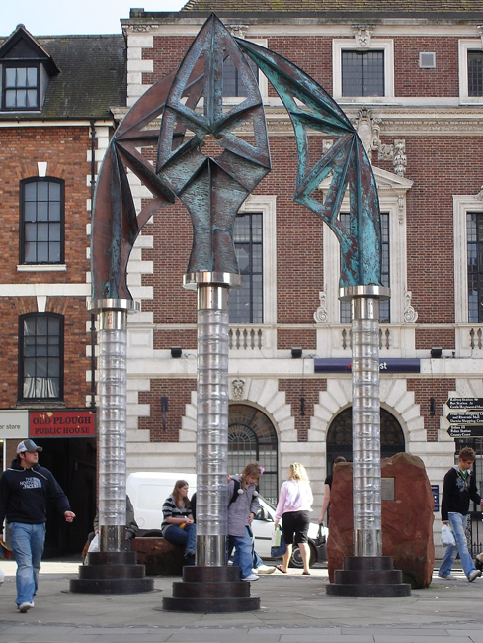
Habash al-Hasib developed a trigonometric algorithm to solve problems related to parallax, which was later rediscovered by Johannes Kepler in 1609, and it is now known as Kepler's equation.

Slide 10
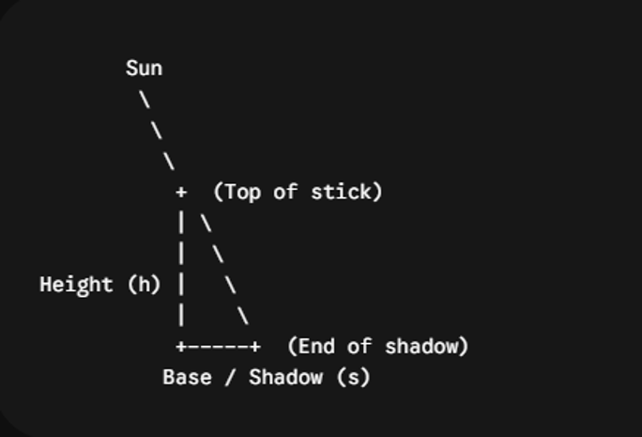
In the year 829, there was a solar eclipse, Habash al-Hasib al-Marwazi used it to make an important discovery. He figured out how to tell the time by measuring how high the Sun was in the sky
“Shadow” (Umbra or versa) He noticed that when sunlight hits a stick (or any vertical object), it makes a shadow. If you measure: how tall the stick is, and how long its shadow is, then the ratio between them changes as the Sun’s height (angle) in the sky changes. That ratio is what we now call the tangent in trigonometry.

Slide 11
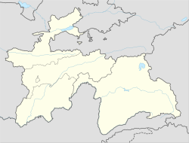
Abd al-Hamid ibn Turk al-Khuttali
Logical Necessities in Mixed Equations
Only a chapter on the solution of quadratic equations has survived
giving a geometric proof that if the discriminant is negative then the quadratic equation has no solution.

Slide 12
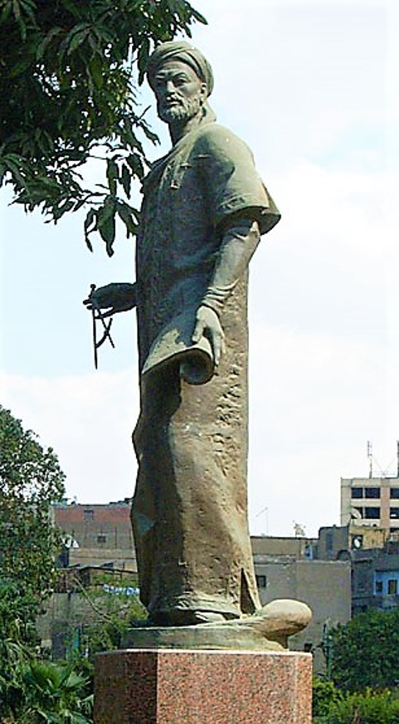
Most reliable information about al-Farghani’s life relates to the year 861. According to available data, in that year he constructed or repaired the nilometer on Rawda island, Cairo
There is no mention of Al Farghani being in the House of Wisdom, theories suggest that it is because of many expeditions and being in the Damascus division of the House of Wisdom.

Slide 13
According to Biruni Farghani was involved in the calculation of the diameter of the Earth by the measurement of the meridian arc length, together with a team of scientists.
“Kitāb fī Jawāmiʿ ʿIlm al-Nujūm” (A Compendium of the Science of the Stars)
833 and 857
Ptolemy’s Almagest

Slide 14
Among his improvements were more accurate calculations of:
The circumference of the Earth,
The tilt of the Earth’s axis, and
The positions of the Sun’s and Moon’s apsides (the points where their orbits are closest to or farthest from Earth).

Slide 15
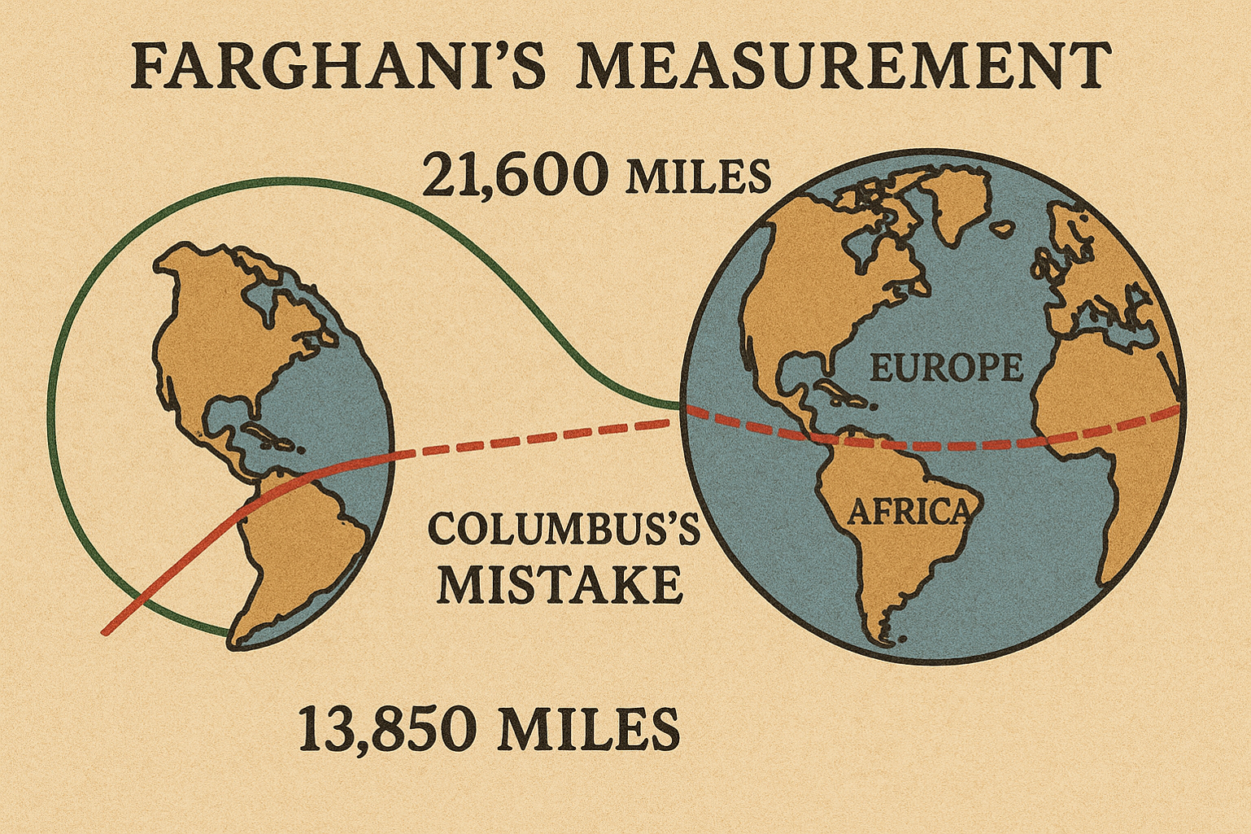
Al-Farghani made a very good estimate of the Earth’s circumference — about 40,200 km, close to the real value. His unit, the Arabic mile (≈1.97 km), was longer than the Roman mile (≈1.48 km).

